Slide 1
Business Intelligence Project for US Organization
MIS 480 Capstone - Business Analytics and Information Systems
William Willette, Ph.D.

Slide 2
Introduction
Haven Life
Term Life Insurance
Business Justification
Access to Client Health Data
Optimize Acceptance Criteria
Mitigate Risk
Notes:
New Haven is a term life insurance company based out of Massachusetts. The organization is seeking advice on how to create new term life insurance plans based on what current industry data can tell them. We have chosen to consult with Haven Life to propose that the company utilize Business Intelligence (BI) tools to ensure continuous access and analysis for client health data. This will optimize their client acceptance criteria while making data informed business decisions regarding term life insurance plans. We’ll take this opportunity to share the BI tools that we’ll use and how we can use those to implement better processes for their company.
Business Justification
New Haven will benefit from business intelligence analysis to create improved life
insurance policy models based upon the Risk-Adjusted Inpatient Mortality Rates and
Hospital Ratings for California Hospitals 2012 data (Yang, 2016, May 2). The purpose of this data analysis is to determine if the risks associated with mortality rates were suitable for predicting which clients would be high risk for premature death. Additionally, using BI tools will allow Haven Life to successfully mitigate risk from analyzing this data to ensure insurance fraud isn’t occurring. As a result, new risk assessment models can be developed to categorize clients and improve business processes.
Reference
Yang, Y. (2016, May 2). Risk-Adjusted Inpatient Mortality Rates and Hospital Ratings for California Hospitals, 2012. Retrieved from https://healthdata.gov/dataset/risk-adjusted-inpatient-mortality-rates-and-hospital-ratings-california-hospitals-2012
Brittany

Slide 3
Discovery
Current Capabilities
Limited data sets
No BI tools
Initial Baseline Measures
Sex
DOB
Nicotine Use
Health Categories
Residence Location
Notes:
Assessment of Current Capabilities
Currently, Haven Life is only assessing five factors when considering new clientele: sex, date of birth, nicotine use, three categories of health, and residence location; and they are not utilizing any business intelligence tools. These categories limit the information and predictions that can be potentially pulled from a more thorough analysis from a bigger data set. A more in-depth review of the data can certainly provide Haven Life with a more tailored business intelligence experience and also help them make more informed business decisions.
Develop Baseline Measures
A typical baseline measure would start before an intervention was taken; therefore, the initial baseline measures will come from the analysis of sex, date of birth, nicotine use, three categories of health, and residence location. These are the five factors that Haven Life was using before hiring this team to consult with them, therefore, this is the initial data that we’ll want to start with.
Brittany

Slide 4
Baseline and gap analysis
Established Baseline Measurements
Notes:
Establish baseline measurements
Specify performance targets
Brittany

Slide 5
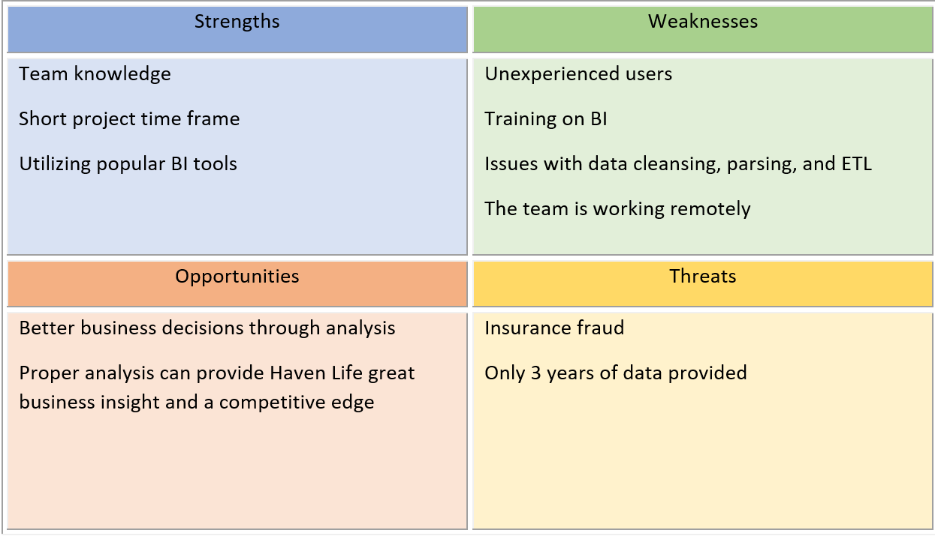
Baseline and gap analysis
Notes:
Thanks Brittany, we found gaps in the data provided by Haven Life, being that there were only being 3 years of data provided for analysis. This can skew the interpretation of the data and ultimately lead to inaccurate decision making. There will need to be a thorough training period once the BI is adopted to ensure that all users are able to utilize the tools.
Feasibility
Technical Feasibility: To minimize the technical risks the technology that will be used are Windows based systems, which most people are familiar with. In using Windows, the users should be familiar with the operating system already and can focus on learning the BI tools.
Although there are several different programs being used, the 5 members of this team will prove enough for completing this project within the 4-week time frame.
The compatibility of the BI and the technology it will be used on will cause no issues as all software is available for all Windows systems.
Economic Feasibility: The 4-week project will require $1,000 contributions from the 5 stakeholders with an overall cost of $20,000. The computer systems are already available so there will be no costs associated with that. The BI tools will have a cost associated with them except for PostgreSQL, which is free for users. SAS Analytics Pro is the most basic package offered and cost $8,700 for the first year. Pentaho offers a subscription-based pricing model which is dependent on the number of users.

Slide 6
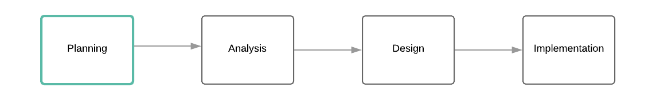
Plan
Notes:
Infrastructure and Capability: Haven Life’s technical infrastructure consists of Windows based operating systems which are compatible with the BI tools that will be used for the analysis. The current infrastructure does not need any major changes other than the addition of the BI tools.
Program Plan: Haven Life needs a system that will provide valuable business insight that will allow them to determine patient acceptance. The sheer amount of data that is available for analysis is overwhelming, and without the proper analytical tools can be impossible to turn the necessary data into useful information. The goal of this project is to provide Haven Life with the tools necessary to make accurate and effective business decisions using business intelligence.
The BI project is technically and economically feasible and can be completed in a 4-week period with minimal upgrades to the technical infrastructure.
The project plan includes 5 members from our consulting firm Kurtis Sherman who will serve as the project manager, Brittany Wentworth, Erica Ardian, Donnie Moore, and myself. With the project scheduled for completion in 4 week we will be using parallel development for this project. This will allow the team to work on different aspects of the system at the same time to ensure that the project is completed on time.

Slide 7
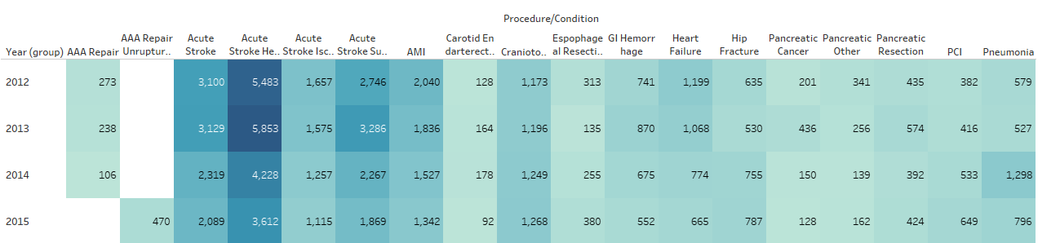
Business Analysis
Notes:
Josh
BI tool benefits:
It can be difficult to make decisions when managing large amounts of data, which is why utilizing BI tools can be extremely beneficial. BI tools allow for valuable insights into the business, visualization of data and information, data mining, and eliminates guesswork (Adair, 2019). Compared to traditional analysis, BI allows for isolation of inaccurate data, identification of outliers, quick view of issues that needs to be addressed, and precise decision making (Rohloff, 2011).
Requirements:
Business requirements: This system will leverage the data from Risk-Adjusted Inpatient Mortality Rates and Hospital Ratings for California Hospitals 2012 to help Haven Life take make informed decisions on patient acceptance and minimize fraud cases.
Functional requirements: The system will perform statistical analysis showing correlation between conditions or procedures and mortality rate. The system will analyze data showing deaths per hospitals as well as the hospitals with higher death couts.
Non-functional requirements: The system will be compatible with all Windows devices. Managers will have access to all data and analysis, as well as ability to grant permissions for additional users as needed.
Performance measures and KPI:
To increase client acceptance criteria we will look at the data from Risk-Adjusted Inpatient Mortality Rates and Hospital Ratings for California Hospitals, 2012 to see the mortality rate by year from 2012 to 2015 and perform analysis. The BI tools used for the analysis are Pentaho, PostgreSQL, and SAS. Each of these tools plays an important part in analyzing the data which will provide valuable insight and will assist Haven Life with making effective business decisions.
This was an overview of the business analysis, next Donnie Moore will discuss our data modeling.

Slide 8
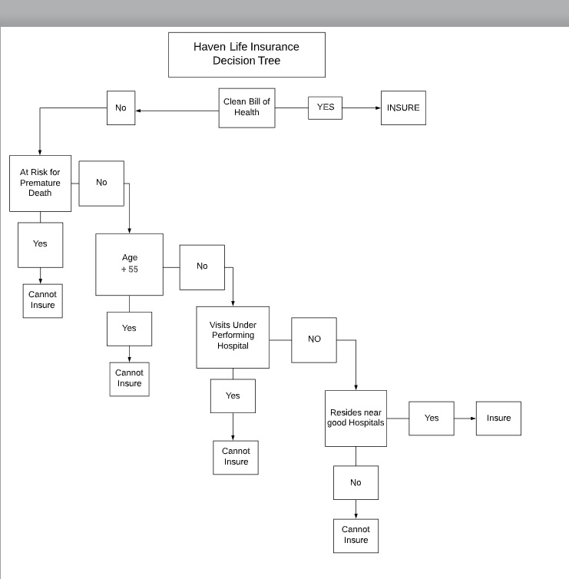
Modeling
Selected Data Set:
California Hospital Ratings and Mortality Rates
The data set accurately depicts factors insurance companies use to qualify insurance policies.
Notes:
California Hospital Ratings and Mortality Rates is the data set of choice. California has the largest population in the United States therefore Safe Haven should be aware of the possible clientele located in that state. This dataset gives insight on the health conditions that lead to premature risk within California. Some of the categories contained inside of the dataset are: hospital location, mortality rate by health condition, hospital death count and other information that is useful. Equipping Safe Haven with a decision tree will ease the decision making process for the company. While forming the decision tree statistical evidence was used to shape the questions. We found pre existing medical conditions, age, hospitals and location all to be important factors for the insurance company to consider. Data explorations, analysis of covariance were among several analytical models used to develop statistical evidence. All of these procedures were completed inside of SAS.

Slide 9
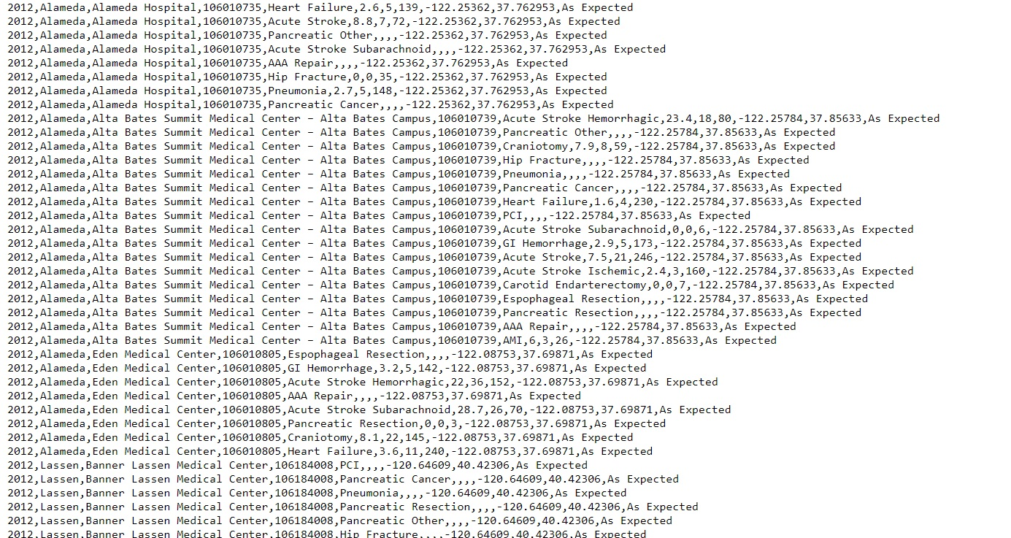
Design, Develop, Deploy data warehouse
Initial Repository
Data Storage Methods
Pentaho
PostgreSQL
SAS
Notes:
The initial data repository/data library was constructed from the data extracted from the online medical database. The initial data repository contained all of the data capable of being analyzed. However all of the data extracted is not fit to be used. The data inside of the repository will need to be cleansed and normalized. Before the data is cleaned and normalized it is considered as ‘raw data’. Raw data can be broadly defined as information collected by a researcher to understand phenomena under investigation (Leech and Onwuegbuzie, 2008). The data quality concerns were addressed in Pentaho. After the raw data was cleansed inside of Pentaho, this repository was loaded into another data storage area. The cleansed data will be exported from Pentaho and imported into PostgreSQL. Inside of PostgreSQL the data will be further formatted. This stage was the final preparation before the data was moved once again into the final storage area, SAS. Inside of SAS a series of analytical procedures will be performed on the data. SAS is capable of performing countless analysis on the data and return results in a series of charts and graphs.
References
Leech, N. & Onwuegbuzie, A. (2008). Raw data. In L. M. Given (Ed.), The SAGE encyclopedia of qualitative research methods (pp. 729-730). Thousand Oaks, CA: SAGE Publications, Inc. doi: 10.4135/9781412963909.n367

Slide 10
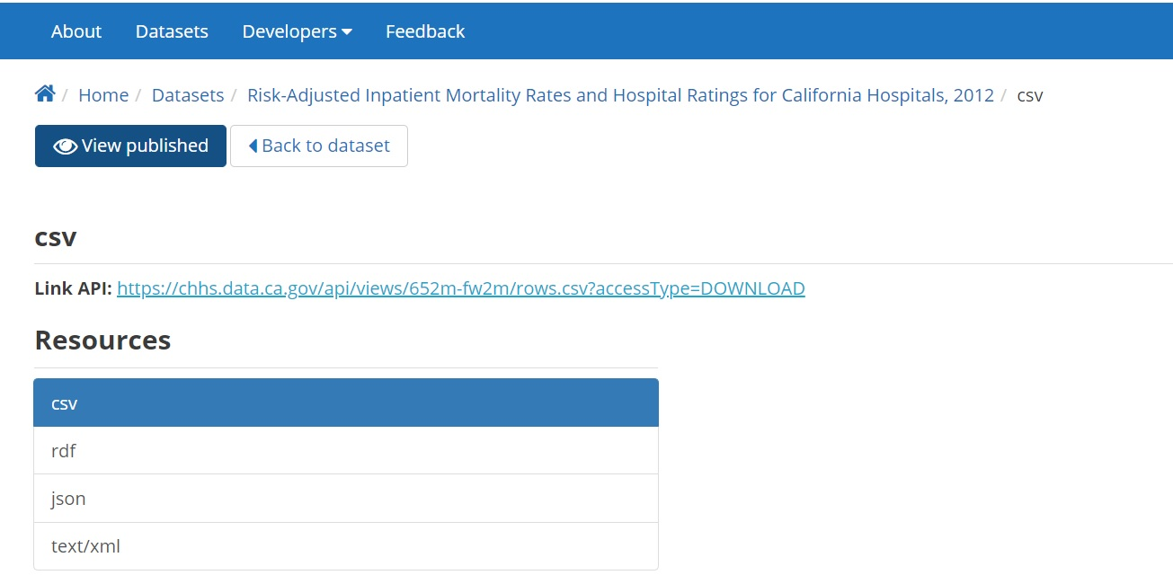
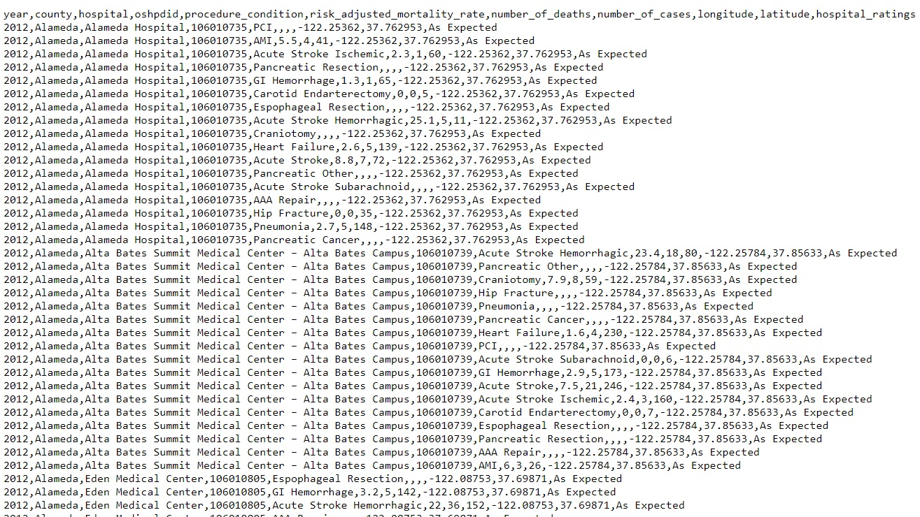
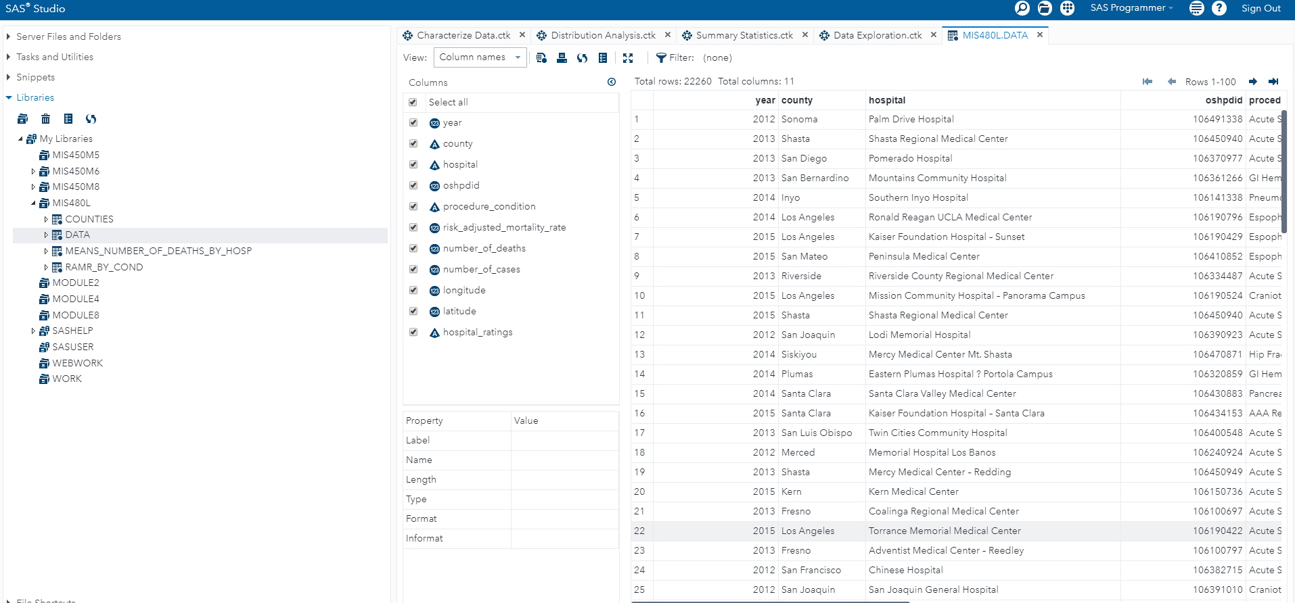
Data integration
Transformation into Analytical Platform
Data Extraction
Raw Data
Notes:
The data used to analyze the California Hospitals was gathered from and online database. The data that was gathered had to undergo a data cleansing procedure. Pentaho was used to cleanse the data. This process included removing or editing data that was incomplete, duplicated or incorrectly formatted. The use of Pentaho enabled the data quality to be significantly increased. During this procedure the data underwent a complete transformation. Once the data is cleansed it will be extracted. The extraction process was completed through a series of code.
The cleansed data was then imported into PostgreSQL. Inside of PostgreSQL, data types are assigned along with numerous of other formatting methods. PostgreSQL is the final step of data transformation before it will upload into the analytical platform SAS. Once the data is deemed fit, it will once again extracted to be imported into another data storage. Inside of SAS all of the analytical work was performed. It is highly important that all of the transformation processes were handled correctly. The prerequisite of any successful application of statistical method is to manage the collected data set, and SAS is developed for data analysis (Frey, 2018). Changes to data within SAS would slow the analytical process however it is possible.
References
Frey, B. (2018). The SAGE encyclopedia of educational research, measurement, and evaluation (Vols. 1-4). Thousand Oaks,, CA: SAGE Publications, Inc. doi: 10.4135/9781506326139

Slide 11







Data quality and BI Analysis Tools
SAS
Pentaho ETL
PostgreSQL
Raw data
Data Quality
Analysis
Notes:
Data Quality: We discovered some data quality problems during the extraction and transformation phase of the Risk-Adjusted Inpatient Mortality Rates and Hospital Ratings for California Hospitals, 2012 csv data. Two primary problems were found using the Pentaho ETL software to parse the comma separated value (CSV) file. First, some numeric data columns only had decimal point characters preventing conversion to numeric values. Second, the data contained aggregated state wide values in addition to the granular hospital data. In order to identify the relationships between condition_procedure and mortality, the CSV file was corrected using Excel and reran through the Pentaho ETL workflow (Foreman, Marquez, Dolgert, Fukutaki, Fullman, Mcgaughey, Murray, 2018). Removing the aggregated statewide data allowed for accurate covariance analysis to determine if the condition_procedure contained statistically significant results.
BI Tools and techniques: Statistical Analysis System was used for the data analysis. The one-way ANOVA models and Analysis of Covariance identified high-risk procedures. Statistical analysis models were used to identify high death count hospitals. The Bubble Map of mortality rates by Latitude and Longitude provided little data value. It would be unethical to associate a client’s home address to a mortality event or rate. The client may choose a lower mortality rate hospital even though they are geographically closer to a high mortality rate data point.
References
Latest Pentaho Data Integration (aka Kettle) Documentation - Pentaho Data Integration. (2019). Retrieved from https://wiki.pentaho.com/display/EAI/Latest Pentaho Data Integration (aka Kettle) Documentation
Foreman, K., Marquez, N., Dolgert, A., Fukutaki, K., Fullman, N., Mcgaughey, M., … Murray, C. (2018). Forecasting life expectancy, years of life lost, and all-cause and cause-specific mortality for 250 causes of death: reference and alternative scenarios for 2016–40 for 195 countries and territories. The Lancet, 392(10159), 2052–2090. https://doi.org/10.1016/S0140-6736(18)31694-5
Statistical Analysis System [Computer software]. (2019). Retrieved from https://www.sas.com
Yang, Y. (2016, May 2). Risk-Adjusted Inpatient Mortality Rates and Hospital Ratings for California Hospitals, 2012. Retrieved from https://healthdata.gov/dataset/risk-adjusted-inpatient-mortality-rates-and-hospital-ratings-california-hospitals-2012
Kurtis

Slide 12


Design: Reporting and Ad hoc Queries
SAS
Business Intelligence
PostgreSQL
Ad hoc
Power Users
SQL
Notes:
We designed the data visualization reports while keeping ethical issues in mind and identified two primary consumers of data.
The first consumer group is Haven Life Business Intelligence Consumers. For Haven Life client risk categories, the histogram graphs and procedure_condition correlation analysis graphics can be used to identify new client acceptance models based upon the risk of clients previous medical procedures or conditions. The client risk models are primarily associated with the procedure_conditions applicants who have been diagnosed with or have had the procedure data performed.
The second consumer group for our data is Haven Life data scientists. We understand the need for a more sophisticated data consumption use case that will scale with Haven Life’s growth. We provide a power user group access level to our cloud based PostgreSQL data warehouse to run Ad hoc queries and generate reports using the data export capabilities of PostgreSQL. This allows Haven Life direct access to our analytic data to create your own custom reports and dashboards enabling data informed decision making.
Kurtis

Slide 13
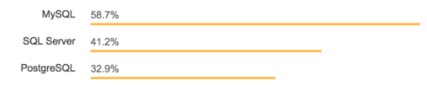
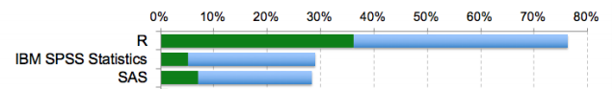
Implementation: Reporting
Pentaho
PostgreSQL
SAS
Rexer, K. (2016, April). The Tools We’re Using [Chart]. Retrieved from https://www.rexeranalytics.com/files/Rexer_Data_Science_Survey_Highlights_Apr-2016.pdf
Tomer, S. (2018, October 1). Most popular databases in 2018 according to StackOverflow survey [Chart]. Retrieved from https://www.eversql.com/most-popular-databases-in-2018-according-to-stackoverflow-survey/
Notes:
For the implementation phase of reporting we researched the most used business intelligence technologies used in current markets.
To perform the ETL, we used the open source Pentaho software suite to save costs. Pentaho offers Big Data ETL features for NoSQL database like MongoDB providing future scalability options for Haven Life data processing. We implemented the ETL transformations in Pentaho to convert the raw csv formatted patient data into a usable tables in the PostgreSQL database.
For the data warehousing implementation we used PostgreSQL, the third most common open source database according to a 2018 StackOverflow survey (Tomer, 2018, October 1). The PostgreSQL database is a common offering from cloud service providers like Microsoft Azure and Amazon Web Services. PostgreSQL hosted on a cloud provider allows Haven Life to scale data processing on demand and perform ad hoc queries to create customized reporting.
For the reporting implementation, we used SAS, the number three most used data analytic tool according to the 2016 Rexer_Data_Science_Survey (Rexer, 2016, April). The SAS source files were uploaded version controlled in GitHub too allow the project to scale into a large organization of multiple developers.
Kurtis
References
Rexer, K. (2016, April). PDF. Retrieved from https://www.rexeranalytics.com/files/Rexer_Data_Science_Survey_Highlights_Apr-2016.pdf
Tomer, S. (2018, October 1). Most popular databases in 2018 according to StackOverflow survey. Retrieved from https://www.eversql.com/most-popular-databases-in-2018-according-to-stackoverflow-survey/

Slide 14
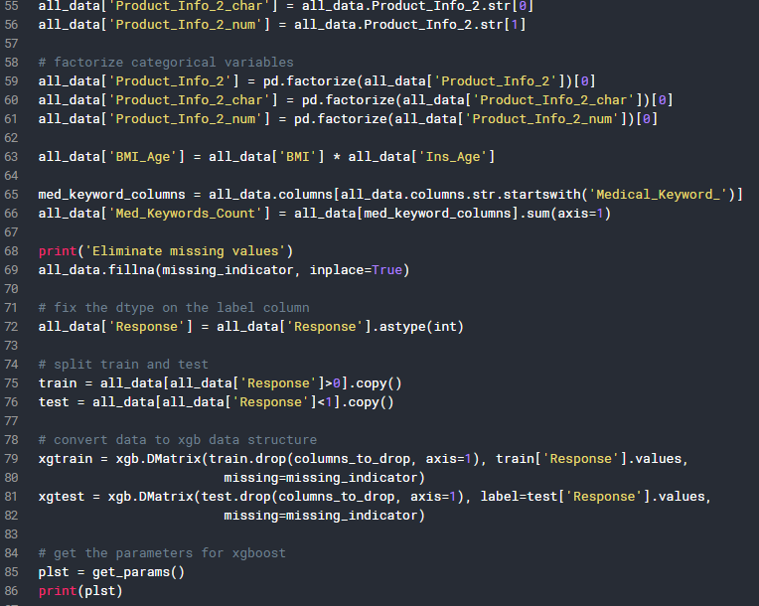
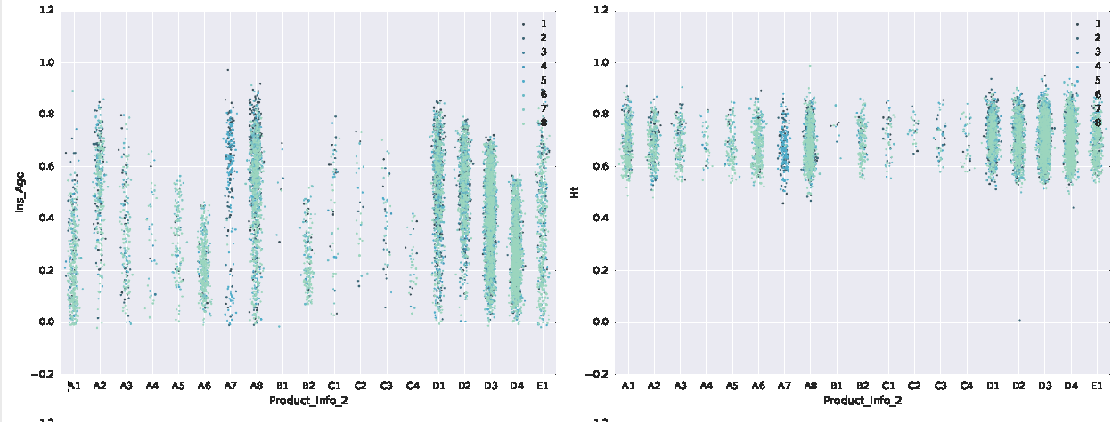
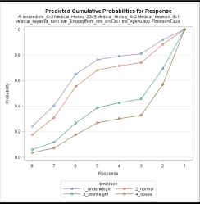
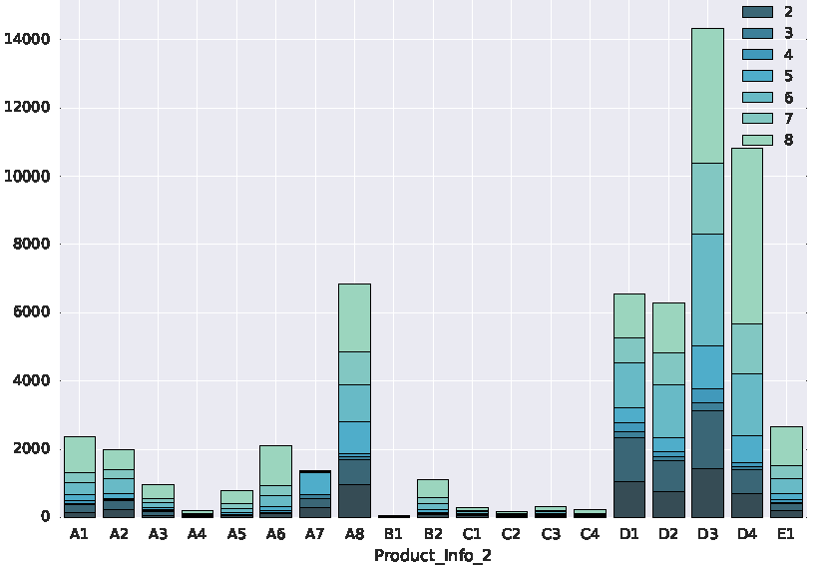
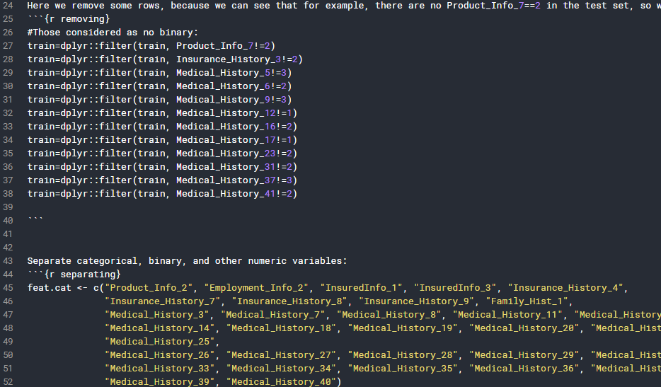
GitHub
https://tinyurl.com/MIS480-Module5-Github
Notes:
Here are some examples of the code that we compiled from the data set from Haven Life Insurance and ran in SAS to analyze the datasets that reflect the primary factors when considering viability of a potential life insurance customer and for client retention(https://tinyurl.com/MIS480-Module5-Github). There are ANOVA statistical analysis that was done by Kurtis initially and run by the rest of the group to show the likelihood of a potential risk on ROI if the potential or current client are hypertensive, obese, have familial genetic factors which would preclude them from stroke, heart attack, etc.(CDC, 2018). I added some of my own code in GitHub in Python to tighten up the data and make it run more efficiently as well as for specific categorical instances that I have represented here in Histogram, Scatterplot and moving time series that correspond the our findings.
ERICA

Slide 15
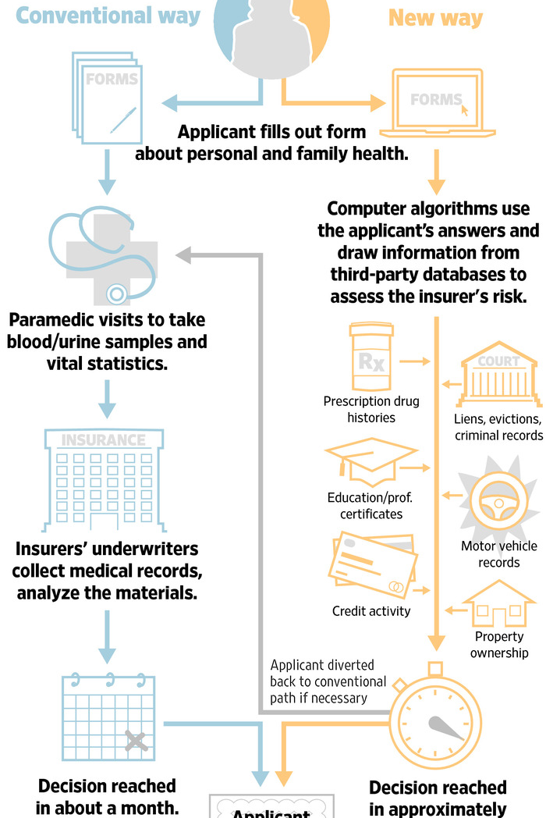
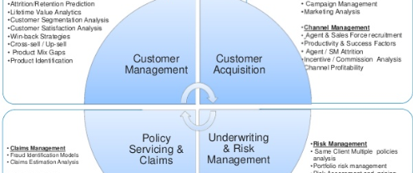
Review Business Analysis
Notes:
Business analysis and implementation of the corresponding BI tools all relate to informed decision making processes in the form of determining which path will be the least TCO (Total Cost of Ownership) vs. ROI (Return on Investment(Richards, G., Yeoh, W., Chong, A. Y. L., & Popovič, A. , 2019). ). Business Analysis incorporates not just the overall data analysis but the combination of this with the BI implementation will create a more agile and informed decision making process by creating a working framework to gain business insights(Deloitte, 2018). Infographics are from Deloitte and I created the second one for the different modalities that are currently considered by Haven Life Insurance for determining client suitability.
ERICA

Slide 16
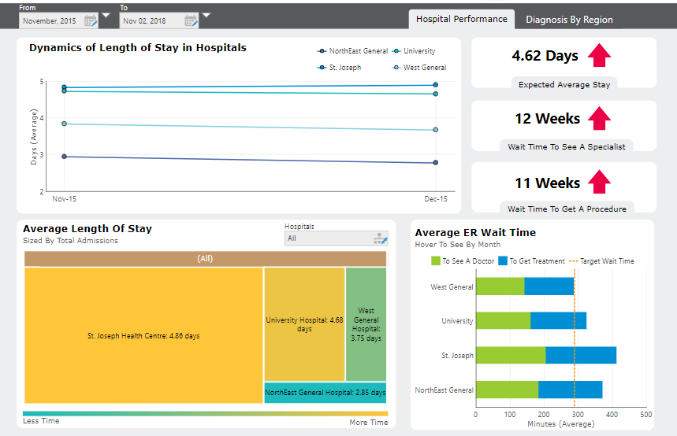
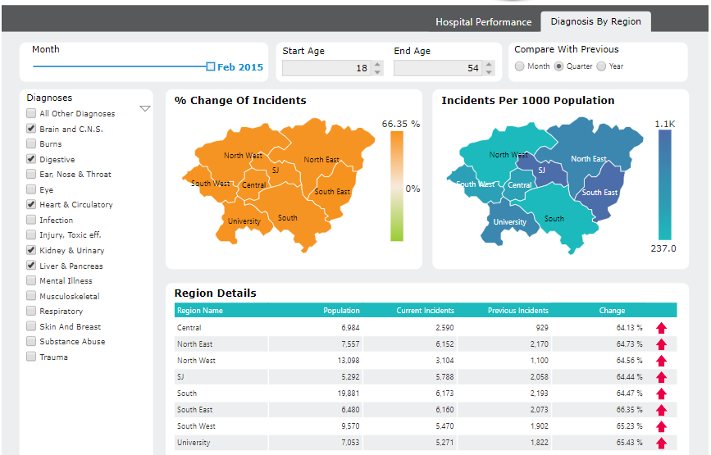
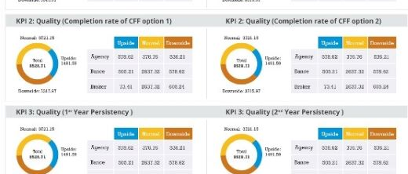
Design: OLAP, dashboards and scorecards
Notes:
Dashboards and sscorecards were an integral part of this project when dissecting and analyzing the bivariate statistical data in the ETL(Pentaho process) (https://tinyurl.com/MIS480-Module5-Github) as well as during the SAS portion here we can see the various snapshots of the hospital performance for a sample set of hospitals that are part of Haven Life Insurance network and their current metrics for different illnesses and mortality rates; these sub categories are from the East Coast sample set of data for a 3yr period from 2015 to 2018(Kim, K. T., Mountain, T., Hanna, S. D., & Kim, N., 2019). This is from a study done from UC Berkeley (2019)that corresponds to the attrition of Life insurance clients and the corresponding reasons companies like Haven Life use these key points for analysis and create a cohesive decision from the data analytics and implement BI to create a better ROI(Etaati, L., 2019). .

Slide 17
Questions?
Notes:
Link to GitHub
Uploaded code, screenshots of data analysis
ERICA

Slide 18
Bibliography references
Notes:
Link to GitHub
Uploaded code, screenshots of data analysis

